Slide 1

WEIHAI RACE PREVIEW
Elite Analysis · August 27 – 30, 2026
USA Triathlon High Performance

Slide 2
Race Week Schedule
Weihai
August 27 – 30, 2026 • Wave to Wonderland, Huancui District, Weihai, Shandong (CST, UTC+8)
Thu • Aug 27
Fri • Aug 28
Sat • Aug 29
Sat • Aug 29
Arrival & Pool Training
Familiarization & Briefing
ELITE MEN — 09:00
ELITE WOMEN — 12:00
09:00 – 18:00 | Information desk + bike mechanic — Weihaiwei Hotel
08:00 – 10:00 | Pool training — Weihai Swimming Pool (25 m, 4 lanes)
14:00 – 16:00 | Pool training — afternoon session
07:30 / 13:30 | Free LOC shuttle hotel → pool (also 08:30 / 14:30)
09:30 – 10:00 | Elite bike course familiarization — 3 laps, officials lead, NO overtaking
10:00 – 11:00 | Elite swim course familiarization — all buoys set, boats + lifeguards
10:15 – 10:45 | Coaches' feedback on FOP to Technical Delegate
14:30 – 15:00 | Pre-race press conference — Brigh Radiance Hotel 12/F
16:00 – 16:30 | ★ Elite Athletes' Briefing — Brigh Radiance Hotel 14/F
16:30 – 17:00 | Team medical meeting + race package distribution
18:00 – 20:00 | Pasta Party — Weihaiwei Hotel 2/F (veg + halal available)
07:30 – 08:30 | Elite Men athletes' lounge check-in
07:45 – 08:45 | Elite Men transition zone check-in
08:15 – 08:45 | Elite Men swim warm-up
08:30 – 08:45 | Opening ceremony — main venue
08:45 / 08:50 | Elite Men line-up (lounge) / introduction (swim exit)
09:00 | ★ ELITE MEN START — 1.5 / 40 / 10
10:55 | Elite Men awards ceremony
10:30 – 11:30 | Elite Women athletes' lounge check-in
11:00 – 11:45 | Elite Women transition zone check-in
11:15 – 11:45 | Elite Women swim warm-up
11:15 – 11:45 | Elite coaches run course measurement
11:45 / 11:50 | Elite Women line-up / introduction
12:00 | ★ ELITE WOMEN START — hottest part of the day
14:10 | Elite Women awards ceremony
Times Wave to Wonderland, Huancui District, Weihai, Shandong (CST, UTC+8). Schedule confirmed from World Triathlon race-info page / athlete guide; subject to organiser updates.

Slide 3
Key Course Differentiators
Weihai
WEIHAI
COURSE AT A GLANCE
WTCS Weihai returns to the Wave to Wonderland venue on China's Shandong peninsula for the 2026 Championship Series. Weihai is one of the most established venues on the calendar, hosting elite racing since 2011 and stepping up from World Cup to WTCS in 2024. The format is standard distance: a 2-lap 1.5 km sea swim, a lap-heavy 8 × 5 km bike, and a flat 4 × 2.5 km seafront run. Two things separate this edition from recent history. First, the date moves to 29 August, roughly four weeks earlier than the 2024 and 2025 editions, which points at 2023-style heat rather than the milder late-September conditions of the last two years. Second, and more important tactically, the men start at 09:00 and the women at 12:00, into peak midday sun. WT's recorded race-day temperature has come in about 4 °C higher for the women in every measured edition, and since ambient air only warms ~1 °C across those three hours here, that gap is essentially solar load on an unshaded seafront course.
Swim:
1.5 km – 2 laps × 750 m
Bike:
40 km – 8 laps × 5 km
Run:
10 km – 4 laps × 2.5 km
Format:
Standard Distance (WTCS)
COURSE FEATURES
Bike Laps:
8
Run Laps:
4
• STANDARD distance (1.5 km / 40 km / 10 km) at WTCS tier — 1000 points to the winner.
QUICK LINKS
• Non-wetsuit is effectively certain: water has measured 24-26 °C and been ruled wetsuit-forbidden in all four recorded editions.
Current Race Info:
Race Info | 2026 WTCS Weihai
• 8 × 5 km bike with a turnaround every lap — the most lap-dense, surge-heavy bike course on the preview set.
• Heat is asymmetric: men 09:00, women 12:00 into peak sun. Recorded race temps run ~4 °C higher for the women.

Slide 4
Course Profile & Map
Weihai
[PLACEHOLDER: Insert upcoming course map or race photo here] Right-click → Replace Image, or paste screenshot of the World Triathlon course map PDF.
[PLACEHOLDER: Insert previous year course map or race photo here] Right-click → Replace Image, or paste screenshot of the World Triathlon course map PDF.
2026 Course
2025 Course
Source: https://www.triathlon.org/events/event/2026_world_triathlon_championship_series_weihai
Source: https://www.triathlon.org/events/event/2026_world_triathlon_championship_series_weihai
Discipline | Distance | Laps | Terrain / Notes
Swim | 1.5 km | — | [PLACEHOLDER: e.g. Open-water, Bay of Weihai]
Bike | 38.6 km | 8 | [PLACEHOLDER: e.g. Flat coastal road circuit, closed course]
Run | 10.0 km | 4 | [PLACEHOLDER: e.g. Flat multi-lap, cobblestone city-centre finish]

Slide 5
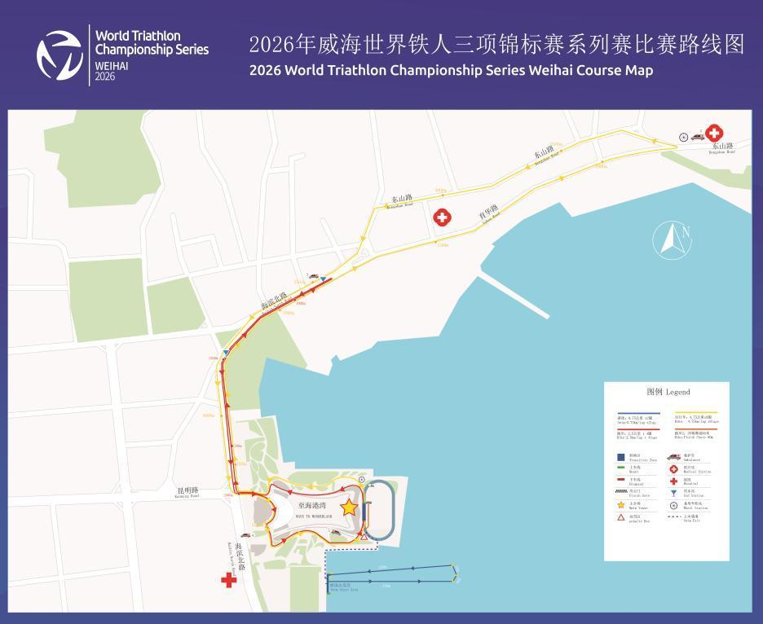
Swim Course Profile
Weihai
1.5 km • 2 × 750 m
Open sea bay — salt water, seafront start
Distance
Layout
Start
1.5 km
Yellow Sea
Waterfront start off the south shore of Wave to Wonderland
Water Temp
Wetsuit
Lap Count
27.8 °C (live)
Forbidden (> 22 °C)
2
Tactical Notes
• Standard-distance swim: 2 × 750 m counter-clockwise laps in the Yellow Sea off Wave to Wonderland
• Salt water and open bay — sighting, swell and chop matter far more here than at the sheltered lagoon venues elsewhere on the calendar
• Water has run 24–26 °C in every measured edition, so this is a reliably warm, reliably non-wetsuit swim — overheating in the swim is a bigger risk than cold
• Water quality sampled 27 May 2026 at three points: pH 8.12–8.48, E. coli and enterococcus both undetected in all three samples
Source: 2026 WTCS Weihai Athletes' Guide (updated 22 July 2026)
• Two laps means a turn/exit sequence mid-swim — position off the first lap decides which bike pack you land in
• Swim familiarization is Friday 28 Aug 10:00–11:00 only; swimming the race course at any other time is prohibited
Not in race brief: Buoy count and exact turn configuration (not published in the guide) • Tide and current data for race morning (open-bay venue; not published)

Slide 6
Bike Course Profile
Weihai
40 km • 8 × 5 km loops
Closed city roads — Haibin North Rd, Yuhua Rd turnaround, Dongshan Rd
Elevation / Lap
Total Climb
Avg Grade
Flat (no data)
—
—
Max Climb Grade
Wind
Loops
—
Coastal — guide gives August max average 5 m/s (~18 km/h), prevailing SE
8 × 5 km
Tactical Implications
• 8 × 5 km laps = 40 km, the highest lap count of any 2026 preview venue — a turnaround every lap means 16+ hard decelerations and re-accelerations
Source: 2026 WTCS Weihai Athletes' Guide (updated 22 July 2026) + WT race info
• Route: transition at the Wave to Wonderland running track, north on Haibin North Rd to the Yuhua Rd turnaround, left onto Dongshan Rd, back down Haibin North Rd
• Lap-heavy, turnaround-heavy design punishes riders who sit at the back of the pack — repeated surges out of each turn are where the accordion effect bites
• Two wheel stations: team wheels at the transition exit, neutral wheels at the bike turnaround. Neutral stock covers rim, 140 mm and 160 mm disc, 11- and 12-speed
• Spare wheels must be registered at Registration on race day and labelled with athlete name, race number and country
• Coastal seafront exposure on Haibin North Rd — the guide's prevailing SE wind will be a cross/head component on one leg of every lap
Flat course — published profile shows no significant climbs. No elevation chart synthesized; if a race GPS FIT becomes available, real contours will replace this block.

Slide 7
Run Course Profile
Weihai
10.0 km • 4 × 2.5 km
Closed seafront road — Haibin North Rd out-and-back
Distance
Lap Structure
Total Climb
10.0 km
4 × 2.5 km
Not published
Avg Grade
Max ▲ / ▼
Heat Risk
—
Not published
MODERATE (men 09:00) / HIGHER for women (12:00 sun load)
Tactical Notes
• 4 × 2.5 km laps = 10 km: north up Haibin North Rd to a turnaround, u-turn, return to transition, then into the finish chute at the main venue
• Pure out-and-back on a seafront road — no technical features, so this is an honest 10 km where run legs are fully exposed
• Three aid stations with sealed bottled water AND iced sponges — the sponges matter, this is the hottest run on the current preview set
• Run penalty box sits near the dismount line and is passed every lap; bike drafting tickets are expensive over 4 laps
Source: 2026 WTCS Weihai Athletes' Guide (updated 22 July 2026)
• HEAT IS NOT SYMMETRIC: WT's recorded race-day air temp has been 3.9–4.7 °C higher for the women in each of the last three editions (2023, 2024, 2025)
• Ambient climatology only warms ~1 °C from 09:00 to 12:00 here (coastal sea breeze), so most of that recorded gap is midday SUN and on-course radiant load, not air temperature. Shade is nil on this seafront out-and-back
• 2026 moves to 29 August, ~4 weeks earlier than the 2024/2025 editions. The closest analogue is 2023 (26 Aug), the hottest on record here: 27.2 °C men / 31.9 °C women
Not in race brief: Elevation profile (not published; seafront road, assumed flat to gently rolling) • Exact aid-station distances (guide confirms three stations but not their placement)

Slide 8
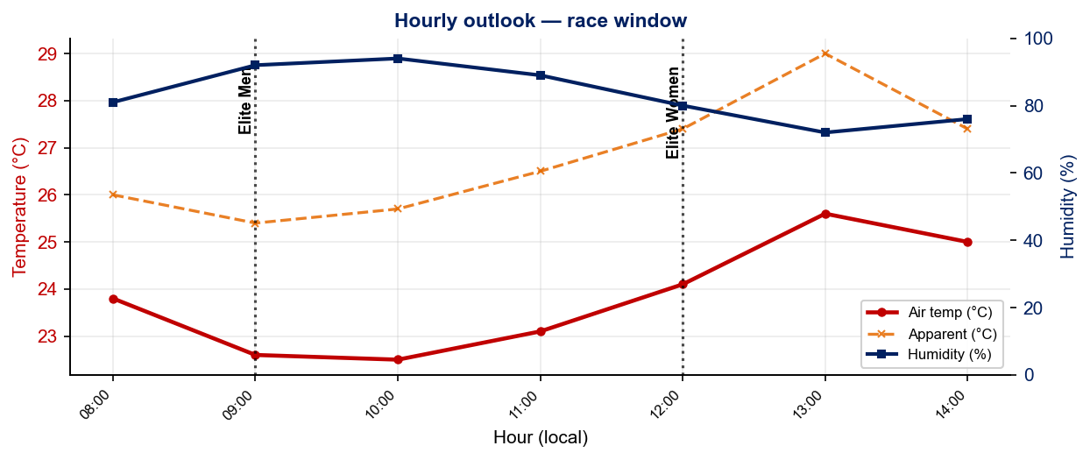
Race-Day Weather Outlook
Weihai
2026-08-29 • Forward forecast — Open-Meteo (≤16 days)
Elite Men — 09:00
Temperature
Apparent / Heat
Humidity
22.7 °C
25.9 °C
92%
Wind
UV peak
Heat Stress
9.3 km/h
5.5
MODERATE
Elite Women — 12:00
Temperature
Apparent / Heat
Humidity
24.9 °C
27.9 °C
76%
Wind
UV peak
Heat Stress
8.3 km/h
4.0
MODERATE
Hydration & Cooling Cues
• Standard heat protocol — pre-cool 10 min, sponges/ice at every aid station, target 600–800 ml/h on bike
• Men's race runs 2.2 °C hotter than women's — heat-acclim work + heavier cooling kit for the 12:00 start
Data source: Open-Meteo. Forecast refreshes every run. Historical Race Conditions slide shows what actually happened in prior years.

Slide 9
Travel & Arrival Load
Denver, CO → Weihai race week
Core travel read
The longest trip on the 2026 calendar. Denver → Weihai (WEH) needs two or three legs, typically DEN to a US west-coast gateway, then a trans-Pacific into Beijing/Shanghai/Seoul, then a domestic hop or the high-speed rail into Weihai. Budget 24–30 h door to door and plan 4–5 days on the ground: CST is UTC+8, 14 hours ahead of Denver (MDT), which is close to maximum circadian disruption. A CHINESE VISA IS REQUIRED for most nationalities — request the invitation letter early via Ms. Ye Sinan (yesinan@ctsa.org.cn). LOC transfers are free from the airport, rail stations and port between 25–30 Aug, but ONLY if arrival details are submitted by 15 August; miss that deadline and there is no pickup.
Primary route
Time zones
Airport Transfer
Rail alternative
Hotel → Venue
DEN → WEH
+14h
WEH → Hotel
Weihai North HSR
0.8 km
2–3 legs via PEK/PVG/ICN
CST UTC+8 vs Denver MDT
46.2 km / ~50 min
8.4 km / ~18 min to hotel
Walking distance
Host Hotel / Accommodation
China-Specific Practical Notes
• Official hotel: Weihaiwei Hotel, No. 82 Haigang Road, Huancui District — 0.8 km from the main venue, an easy walk. 498 CNY/night single or twin, breakfast included.
• POWER BANKS: mainland domestic flights require the 3C/CCC logo — non-certified banks are routinely confiscated, including at transit security on a domestic connection. Under 100 Wh, carry-on only, never checked.
• Briefing and press conference are at the Brigh Radiance Hotel, ~500 m from the official hotel (briefing Fri 28 Aug 16:00–16:30).
• Payment is QR-dominant (WeChat Pay / Alipay); link an international card before travelling and carry ¥500–1,000 cash for edge cases.
• Amenities: free Wi-Fi, fitness centre, free laundry on the 2nd floor, two bottles of water and fruit per room daily, free room-service delivery.
• Electricity 220 V / 50 Hz. Plug types A (US flat), I (AU) and some C (EU) — most hotels have universal sockets, but bring an adapter.
• Athlete/coach set meals 198–498 CNY per person in Liugong Island Hall (2/F). Pasta Party Fri 28 Aug 18:00–20:00, vegetarian and halal available.
• Pool training available 27–28 Aug at Weihai Swimming Pool (25 m, 4 lanes reserved, free) with a free LOC shuttle from the hotel at 07:30/08:30/13:30/14:30.
• Weihai Municipal Hospital is ~1,600 m from the venue. Venue medical is free; hospital treatment is athlete-paid, so carry insurance.
• Bike and run training is on open public roads at the athlete's own risk; only the race venue gets traffic control, and only on familiarization and race day.

Slide 10
Environmental Risk Profile
Weihai
RACE-DAY WEATHER (09:00–14:00 local)
AIR QUALITY (Open-Meteo archive)
Year | Date | Air Temp | Humidity | Wind km/h | Precip mm
2018 | Sep 22 | 23.5°* | 39% | 9 | 0.0
2019 | Sep 21 | 23.3°* | 66% | 20 | 0.0
2023 | Aug 26 | 27.2 | 60% | 16 | 0.0
2024 | Sep 27 | 24.1 | 62% | 14 | 0.0
2025 | Sep 26 | 24.9 | 78% | 8 | 0.0
2026 | Aug 29 | 24.1 | 84% | 9 | 1.3
Year | PM2.5 | EU AQI | UV Index | Risk
2018 | — | — | — | —
2019 | — | — | — | —
2023 | 22.0 | 50 | 5.2 | Moderate
2024 | 8.9 | 47 | 4.3 | Moderate
2025 | 45.5 | 87 | 4.5 | Very Poor
2026 | 14.5 | 46 | 2.1 | Moderate
HEALTH & WATER QUALITY RISK FACTORS
• Water Quality: [PLACEHOLDER: Historical water quality data for Weihai — e.g. bacterial counts, EU Bathing Water Directive status, known algae / pollution events. Check local environmental agency reports for May race window.]
• Athlete Health Incidents: [PLACEHOLDER: Any known GI illness, respiratory, or heat-related incidents at this or comparable venues. E.g. Sunderland 2023 — reported GI illness post-swim for multiple athletes.]
• Water Temperature: [PLACEHOLDER: Historical open-water temperature for Weihai in May (not available from Open-Meteo; check Copernicus Marine / NOAA or WT historical results).]
• Heat / Humidity Risk: Auto-derived from above table — flag if humidity >70% or air temp >25°C at race time.
Weather and AQ data: Open-Meteo historical archive (archive-api.open-meteo.com). EU AQI: Good ≤20, Fair ≤40, Moderate ≤60, Poor ≤80, Very Poor >80.

Slide 11
Who to Watch — Weihai Race Week
ELITE MEN
ELITE WOMEN
Top 10 by World Ranking
Top 10 by World Ranking
Rank | Athlete | Points
1 | Matthew Hauser | 7,044
2 | Vasco Vilaca | 6,930
3 | Miguel Hidalgo | 6,531
4 | Henry Graf | 6,104
5 | David Cantero Del Campo | 5,583
6 | Csongor Lehmann | 5,281
7 | Luke Willian | 4,734
8 | Dorian Coninx | 4,075
9 | Max Studer | 4,054
10 | Tyler Mislawchuk | 4,003
Rank | Athlete | Points
1 | Beth Potter | 7,499
2 | Lisa Tertsch | 7,270
3 | Leonie Periault | 6,586
4 | Jeanne Lehair | 6,112
5 | Cassandre Beaugrand | 5,725
6 | Taylor Spivey | 5,253
7 | Jolien Vermeylen | 5,179
8 | Tilda Månsson | 5,045
9 | Diana Isakova | 4,899
10 | Emma Lombardi | 4,634
Last Year's Podium at Weihai
Last Year's Podium at Weihai
1. Max Studer (01:41:08)
1. Cassandre Beaugrand (01:49:20)
2. David Cantero Del Campo (01:41:18)
2. Beth Potter (01:49:26)
3. Tyler Mislawchuk (01:41:25)
3. Lisa Tertsch (01:49:44)
Rankings = current World Triathlon rankings snapshot; startlist intersect uses program_entries when available.

Slide 12
Top Swim Threats
Weihai
Ranked by Lead Pack % (within 15 s of swim leader — robust to course speed) • EWMA swim split (span-5) shown per distance; Sprint = this race • WTCS / World Cup / Continental, last 4 yrs
ELITE MEN
ELITE WOMEN
# | Athlete | Lead % | EWMA Spr ▸ | EWMA Std | Spr/Std
1 | Alessio Crociani | 100% | 8:39 | 17:19 | 17/4
2 | Michael Gar | 100% | 8:53 | 16:57 | 5/1
3 | Dorian Coninx | 100% | 8:57 | 17:26 | 4/9
4 | Marcus Dey | 100% | 8:57 | 17:10 | 8/4
5 | Miguel Tiago Silva | 100% | 8:58 | 17:41 | 8/11
6 | Vincent Luis | 100% | 8:59 | 18:20 | 2/7
7 | Davide Ingrilli | 100% | 9:04 | — | 3/0
8 | Lawrence Martindale | 100% | 9:12 | — | 3/0
9 | Zheng Xu | 100% | 9:18 | 18:19 | 1/2
10 | Pao Millo | 100% | 9:29 | — | 3/0
11 | Carter Stuhlmacher | 100% | 9:40 | 18:08 | 13/1
12 | Jamie Riddle | 100% | 10:01 | 17:26 | 8/3
13 | Nicholas Quenet | 100% | 10:17 | 18:35 | 5/1
14 | Márk Dévay | 97% | 8:50 | 17:33 | 9/23
# | Athlete | Lead % | EWMA Spr ▸ | EWMA Std | Spr/Std
1 | Tilly Anema | 100% | 9:22 | 19:20 | 5/5
2 | Giorgia Messori | 100% | 9:23 | — | 3/0
3 | Lea Marchal | 100% | 9:30 | — | 4/0
4 | Sophie Alden | 100% | 9:33 | 18:41 | 7/2
5 | Mikayla Messer | 100% | 9:43 | 20:01 | 8/1
6 | Jasmine Greaves | 100% | 9:57 | — | 3/0
7 | Astrid Bergman | 100% | 9:57 | — | 3/0
8 | Saki Yanagihara | 100% | 10:05 | 21:00 | 4/1
9 | Vittoria Lopes | 100% | 10:11 | 19:15 | 7/8
10 | Flora Duffy | 100% | — | 19:01 | 0/4
11 | Bianca Seregni | 93% | 9:02 | 19:25 | 8/19
12 | Britney Brown | 90% | 10:04 | — | 10/0
13 | Sophie Evans | 89% | 9:17 | 19:22 | 3/6
14 | Caroline Theil | 89% | 9:46 | 19:33 | 8/1

Slide 13
USA World Rankings Snapshot
Weihai
As of 2026-08-31 • World Triathlon Rankings • Heading into Weihai • Race tier: WTCS
Max Points Available at this Race
Win
Podium
Top 5
Top 10
Top 15
Top 20
1,000 pts
855 pts
732 pts
495 pts
335 pts
227 pts
ELITE MEN
ELITE WOMEN
Rank | Athlete | Points | Curr | Prev
20 | John Reed | 3,233 | 6 | 6
24 | Reese Vannerson | 2,818 | 6 | 6
33 | Morgan Pearson | 2,585 | 4 | 5
40 | Braxton Legg | 2,442 | 6 | 6
45 | Sullivan Middaugh | 2,281 | 6 | 6
48 | Seth Rider | 2,259 | 6 | 5
68 | Keller Norland | 1,988 | 6 | 6
81 | Chase McQueen | 1,755 | 6 | 6
82 | Blake Bullard | 1,732 | 6 | 6
95 | Darr Smith | 1,619 | 6 | 6
105 | Porter Middaugh | 1,513 | 6 | 6
119 | Zach Leachman | 1,433 | 6 | —
134 | Carter Stuhlmacher | 1,274 | 6 | 3
280 | Cole Jamieson | 600 | 4 | 2
349 | Foster Wilfong | 448 | 4 | —
Rank | Athlete | Points | Curr | Prev
6 | Taylor Spivey | 5,253 | 6 | 4
17 | Gwen Jorgensen | 3,371 | 6 | 6
18 | Gina Sereno | 3,295 | 6 | 6
29 | Danielle Orie | 2,692 | 6 | 5
44 | Erika Ackerlund | 2,273 | 6 | 6
49 | Kelly Wetteland | 2,109 | 6 | 3
54 | Taylor Knibb | 2,047 | 4 | —
59 | Naomi Ruff | 1,968 | 6 | 6
63 | Kirsten Kasper | 1,914 | 6 | 2
96 | Eleanor Beveridge | 1,448 | 6 | 4
102 | Joy Gill | 1,421 | 6 | 6
114 | Rachel Werking | 1,328 | 6 | 3
128 | Michelle Magnani | 1,242 | 6 | 6
143 | Faith Duncan | 1,156 | 6 | —
163 | Katie McCune | 1,042 | 6 | 1

Slide 14
Olympic Qualification Pace
Weihai
Paris 2024 OQR cutoff (30th): 3,626.69 pts ÷ 12-event cap = 302 pts / event on pace
An athlete who averages ~302 pts per event across their best 12 events is on pace to clear the LA 2028 qualifying threshold.
FINISH POSITION AT EACH TIER THAT HITS 302-PT PACE
Tier | Win pts | Last on-pace pos | First off-pace pos (pts) | Verdict
World Championship Series | 1000 | #16 | #17 (287 pts) | Top 16
World Cup | 500 | #7 | #8 (290 pts) | Top 7
Continental Championships (Americas) | 590 | #9 | #10 (293 pts) | Top 9
Continental Cup (Americas) | 280 | None (win = 280) | — | Not achievable
USA MEN
USA WOMEN
Rk | Athlete | Total | Races | On | Off | Pace | Proj @12
17 | Sullivan Middaugh | 1,573 | 5 | 2 | 3 | 314 | 3,776
21 | Reese Vannerson | 1,479 | 4 | 3 | 1 | 369 | 4,439
24 | Seth Rider | 1,341 | 4 | 3 | 1 | 335 | 4,023
25 | Braxton Legg | 1,274 | 4 | 2 | 2 | 318 | 3,823
26 | John Reed | 1,226 | 3 | 2 | 1 | 408 | 4,904
30 | Keller Norland | 1,087 | 3 | 2 | 1 | 362 | 4,349
42 | Chase McQueen | 929 | 5 | 1 | 4 | 185 | 2,230
45 | Morgan Pearson | 904 | 2 | 1 | 1 | 452 | 5,425
70 | Blake Bullard | 513 | 3 | 0 | 3 | 171 | 2,055
73 | Porter Middaugh | 481 | 3 | 1 | 2 | 160 | 1,926
100 | Zach Leachman | 282 | 2 | 0 | 2 | 141 | 1,696
Rk | Athlete | Total | Races | On | Off | Pace | Proj @12
10 | Taylor Knibb | 2,047 | 4 | 4 | 0 | 511 | 6,142
15 | Taylor Spivey | 1,795 | 3 | 3 | 0 | 598 | 7,180
16 | Gina Sereno | 1,785 | 5 | 3 | 2 | 357 | 4,286
17 | Danielle Orie | 1,646 | 5 | 3 | 2 | 329 | 3,951
23 | Gwen Jorgensen | 1,288 | 3 | 2 | 1 | 429 | 5,153
34 | Kelly Wetteland | 925 | 2 | 2 | 0 | 462 | 5,550
38 | Naomi Ruff | 882 | 3 | 1 | 2 | 294 | 3,530
51 | Erika Ackerlund | 720 | 3 | 1 | 2 | 240 | 2,882
62 | Eleanor Beveridge | 567 | 3 | 0 | 3 | 189 | 2,269
75 | Kirsten Kasper | 475 | 2 | 1 | 1 | 237 | 2,854
99 | Rachel Werking | 271 | 2 | 0 | 2 | 135 | 1,629
On = events scoring ≥ pace. Off = events < pace. Pace = total breakdown pts ÷ events raced. Proj @12 = current total + (avg pts × remaining events to cap); green if ≥ Paris cutoff. Cutoff estimate: Paris 2024 = 3,627 pts / 12 events = 302 pts/event. Tier positions use a geometric 0.925 points model. Source: World Triathlon rankings database.

Slide 15
USA Olympic Qualification Snapshot
Weihai
As of 2026-08-29 • Olympic Qualification Rankings (LA 2028 cycle) • Heading into Weihai
ELITE MEN
ELITE WOMEN
Rank | Athlete | Points | Second | First
17 | Sullivan Middaugh | 1,573 | 0 | 5
21 | Reese Vannerson | 1,479 | 0 | 4
24 | Seth Rider | 1,341 | 0 | 4
25 | Braxton Legg | 1,274 | 0 | 4
26 | John Reed | 1,226 | 0 | 3
30 | Keller Norland | 1,087 | 0 | 3
42 | Chase McQueen | 929 | 0 | 5
45 | Morgan Pearson | 904 | 0 | 2
70 | Blake Bullard | 513 | 0 | 3
73 | Porter Middaugh | 481 | 0 | 3
100 | Zach Leachman | 282 | 0 | 2
105 | Darr Smith | 265 | 0 | 2
Rank | Athlete | Points | Second | First
10 | Taylor Knibb | 2,047 | 0 | 4
15 | Taylor Spivey | 1,795 | 0 | 3
16 | Gina Sereno | 1,785 | 0 | 5
17 | Danielle Orie | 1,646 | 0 | 5
23 | Gwen Jorgensen | 1,288 | 0 | 3
34 | Kelly Wetteland | 925 | 0 | 2
38 | Naomi Ruff | 882 | 0 | 3
51 | Erika Ackerlund | 720 | 0 | 3
62 | Eleanor Beveridge | 567 | 0 | 3
75 | Kirsten Kasper | 475 | 0 | 2
99 | Rachel Werking | 271 | 0 | 2
118 | Joy Gill | 200 | 0 | 2
Rankings: latest weekly snapshot. Second / First = events counted in the second vs first scoring period of the LA 2028 OQR cycle. Because the cycle is still in its first year, most results appear under First. Source: World Triathlon rankings database.

Slide 16
ELITE MEN

Slide 17
Race Overview — Elite Men
Weihai
RACE HISTORY AT WEIHAI
3 KEYS TO SUCCESS
The Elite Men race at Weihai has been held 6 times in this analysis window (2018–2026). Max Studer is the most successful athlete in this span with 2 victories. The event is staged as part of the World Cup / World Championship Series calendar. [PLACEHOLDER: Add 1–2 sentences on notable storylines, competitive history, or what makes this event significant for Elite Men athletes. E.g. defending champions, record performances, dramatic finishes.]
1
Swim positioning matters — an average of 17 athletes exit the water within 15 sec of the leader. Entering the bike in the front pack is critical; conserve energy with a disciplined swim line rather than sprinting alone.
2
[PLACEHOLDER: Key 2 — Describe bike strategy: is this a pack race or do breakaways form? What power/tactics are needed to stay in the lead group?]
3
Run speed separates the podium — the fastest run pace averages ~3:02/km with a ~152s spread between fastest and average finisher. Either a pre-built lead from the bike or exceptional run speed is required to win.

Slide 18
Results Summary — Elite Men
Weihai
Year | Date | Category | Field | DNF/LAP/DNS | Winner | Winner Time | Air Temp | Water Temp | Swim km | Bike km | Run km
2018 | Sep 22 | World Cup | 57 | 13 | Iden | 1:53:11 | 23.5°* | — | — | — | —
2019 | Sep 21 | World Cup | 48 | 9 | Silva | 1:54:47 | 23.3°* | — | — | — | —
2023 | Aug 26 | World Cup * | 45 | 11 | Valencia | 1:46:35 | 27.2 | 25.8 | 1.50 | 38.4 | 10.0
2024 | Sep 27 | World Championship Series * | 42 | 7 | Yee | 1:48:21 | 24.1 | 24.4 | 1.50 | 40.0 | 10.0
2025 | Sep 26 | World Championship Series * | 37 | 2 | Studer | 1:40:03 | 24.9 | 24.2 | 1.50 | 38.0 | 10.0
2026 | Aug 29 | World Championship Series * | 45 | 7 | Studer | 1:41:08 | 24.1 | 26.3 | 1.50 | 38.6 | 10.0
* Course distance changed vs. prior year

Slide 19
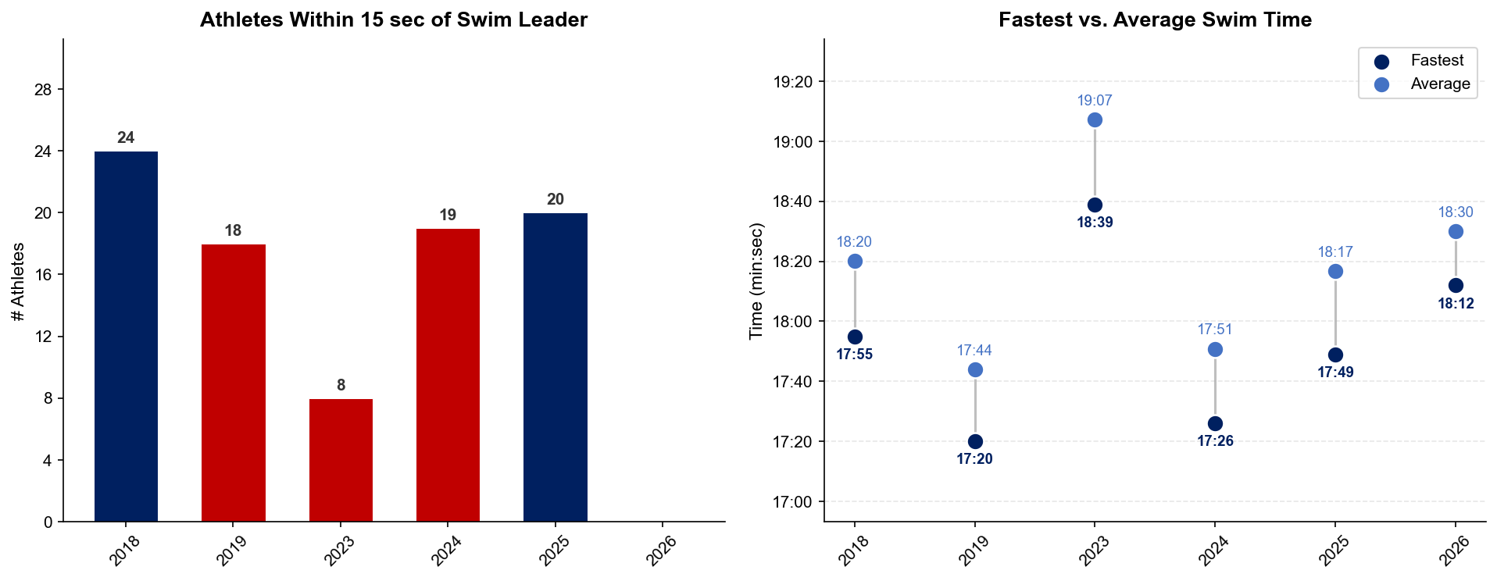
Swim Exit Dynamics — Elite Men
Weihai

Slide 20
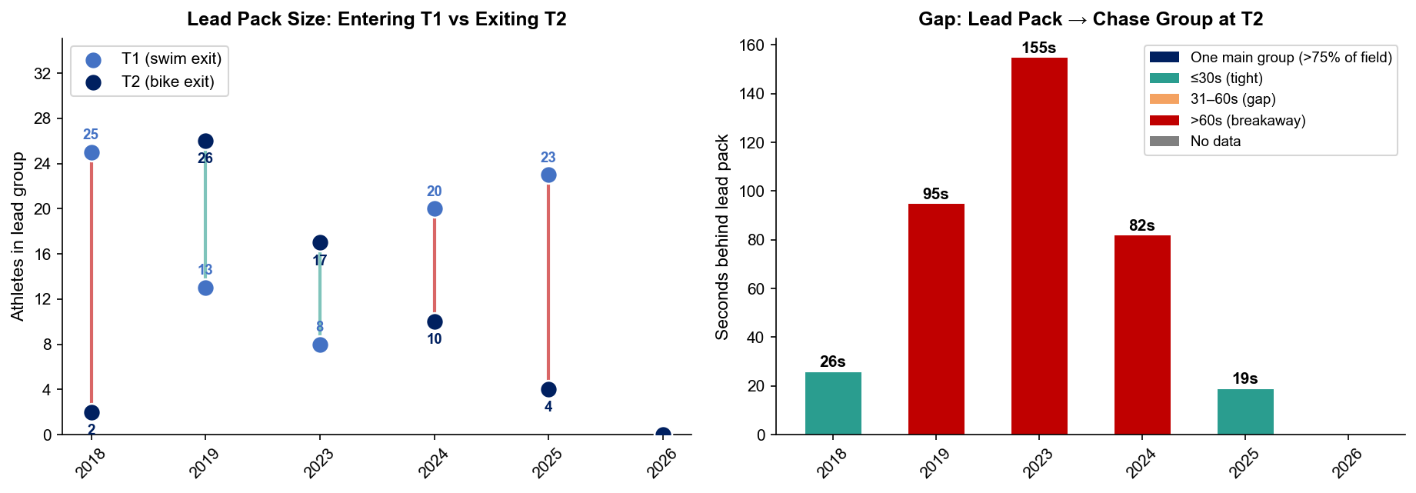
Bike Pack Evolution — Elite Men
Weihai
Lead pack = athletes within 15 sec of leader. T1 = lead group entering the bike; T2 = lead group exiting the bike.
Year | Lead Size @ T1 | Lead Size @ T2 | Change | Chase Group @ T2 | Chase Gap*
2018 | 25 | 2 | -23 | 24 | 26s
2019 | 13 | 26 | +13 | 1 | 95s
2023 | 8 | 17 | +9 | 5 | 155s
2024 | 20 | 10 | -10 | 15 | 82s
2025 | 23 | 4 | -19 | 14 | 19s
2026 | — | — | — | — | —
Lead pack = athletes within 15 sec of leader. Chase group = athletes within 15 sec of the first athlete outside the lead pack. * Chase Gap = seconds from the last lead-pack athlete to the first chase-group athlete at T2.
Dropouts: 2018: 13 DNF/LAP (1 in lead group at t1) | 2019: 8 DNF/LAP (1 in lead group at t1) | 2023: 11 DNF/LAP (2 in lead group at bike) | 2024: 7 DNF/LAP (1 in lead group at bike) | 2025: 2 DNF/LAP | 2026: 7 DNF/LAP (3 in lead group at t1)

Slide 21
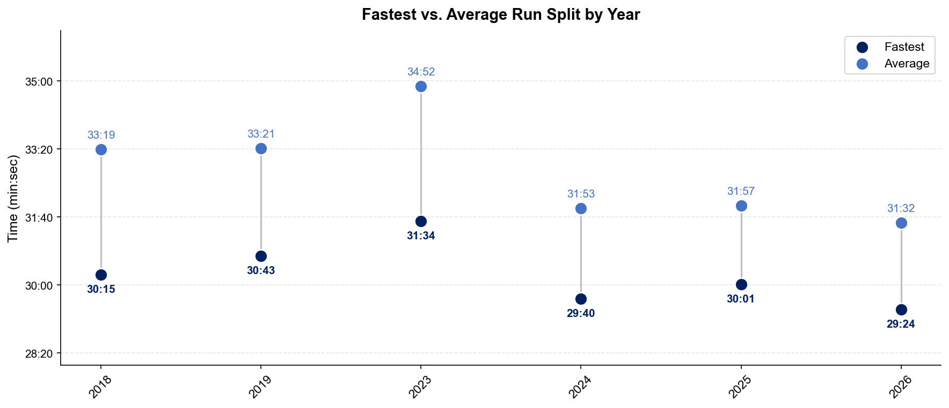
Run Split Analysis — Elite Men
Weihai

Slide 22
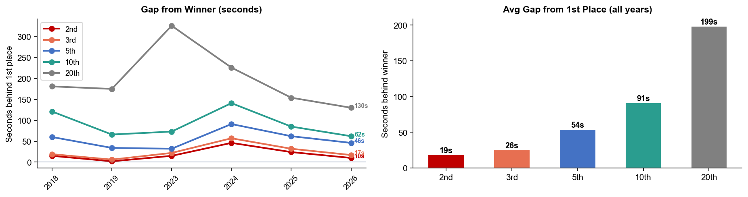
Key Position Times — Elite Men
Weihai
Year | 1st | 2nd | 3rd | 5th | 10th | 20th
2018 | 1:53:11 | 1:53:26 +15s | 1:53:30 +19s | 1:54:11 +60s | 1:55:12 +121s | 1:56:12 +181s
2019 | 1:54:47 | 1:54:49 +2s | 1:54:53 +6s | 1:55:21 +34s | 1:55:53 +66s | 1:57:42 +175s
2023 | 1:46:35 | 1:46:50 +15s | 1:46:57 +22s | 1:47:07 +32s | 1:47:48 +73s | 1:52:01 +326s
2024 | 1:48:21 | 1:49:07 +46s | 1:49:18 +57s | 1:49:52 +91s | 1:50:42 +141s | 1:52:07 +226s
2025 | 1:40:03 | 1:40:27 +24s | 1:40:35 +32s | 1:41:05 +62s | 1:41:28 +85s | 1:42:37 +154s
2026 | 1:41:08 | 1:41:18 +10s | 1:41:25 +17s | 1:41:54 +46s | 1:42:10 +62s | 1:43:18 +130s

Slide 23
Race Conditions — Elite Men
Weihai
Year | Date | Air Temp | Humidity | Wind (km/h) | Precip (mm) | Water Temp | Wetsuit | Conditions
2018 | Sep 22 | 23.5°* | 39% | 9 | 0.0 | — | — | —
2019 | Sep 21 | 23.3°* | 66% | 20 | 0.0 | — | — | —
2023 | Aug 26 | 27.2 | 60% | 16 | 0.0 | 25.8 | forbidden | —
2024 | Sep 27 | 24.1 | 62% | 14 | 0.0 | 24.4 | forbidden | —
2025 | Sep 26 | 24.9 | 78% | 8 | 0.0 | 24.2 | forbidden | —
2026 | Aug 29 | 24.1 | 84% | 9 | 1.3 | 26.3 | forbidden | —
Air temp, humidity, wind, and precipitation sourced from Open-Meteo historical archive (race window 09:00–14:00 local) where WT API data is absent. Values marked * are Open-Meteo estimates. Water temp and wetsuit ruling are from the World Triathlon API per program.

Slide 24
ELITE WOMEN

Slide 25
Race Overview — Elite Women
Weihai
RACE HISTORY AT WEIHAI
3 KEYS TO SUCCESS
The Elite Women race at Weihai has been held 6 times in this analysis window (2018–2026). The event is staged as part of the World Cup / World Championship Series calendar. [PLACEHOLDER: Add 1–2 sentences on notable storylines, competitive history, or what makes this event significant for Elite Women athletes. E.g. defending champions, record performances, dramatic finishes.]
1
Fast swimming is decisive — only ~14 athletes typically leave the water together. A strong swim directly builds a race-winning gap before T1.
2
[PLACEHOLDER: Key 2 — Describe bike strategy: is this a pack race or do breakaways form? What power/tactics are needed to stay in the lead group?]
3
Run speed separates the podium — the fastest run pace averages ~3:26/km with a ~195s spread between fastest and average finisher. Either a pre-built lead from the bike or exceptional run speed is required to win.

Slide 26
Results Summary — Elite Women
Weihai
Year | Date | Category | Field | DNF/LAP/DNS | Winner | Winner Time | Air Temp | Water Temp | Swim km | Bike km | Run km
2018 | Sep 22 | World Cup | 44 | 9 | Spivey | 2:08:02 | 23.5°* | — | — | — | —
2019 | Sep 21 | World Cup | 32 | 5 | Derron | 2:08:03 | 23.3°* | — | — | — | —
2023 | Aug 26 | World Cup * | 34 | 7 | Seregni | 1:58:42 | 31.9 | 25.9 | 1.50 | 38.4 | 10.0
2024 | Sep 27 | World Championship Series * | 28 | 2 | Tertsch | 2:04:42 | 28 | 24.8 | 1.50 | 40.0 | 10.0
2025 | Sep 26 | World Championship Series * | 28 | 1 | Potter | 1:51:58 | 28.9 | 24.3 | 1.50 | 38.0 | 10.0
2026 | Aug 29 | World Championship Series * | 41 | 3 | Beaugrand | 1:49:20 | 24.7 | 26.3 | 1.50 | 38.6 | 10.0
* Course distance changed vs. prior year

Slide 27
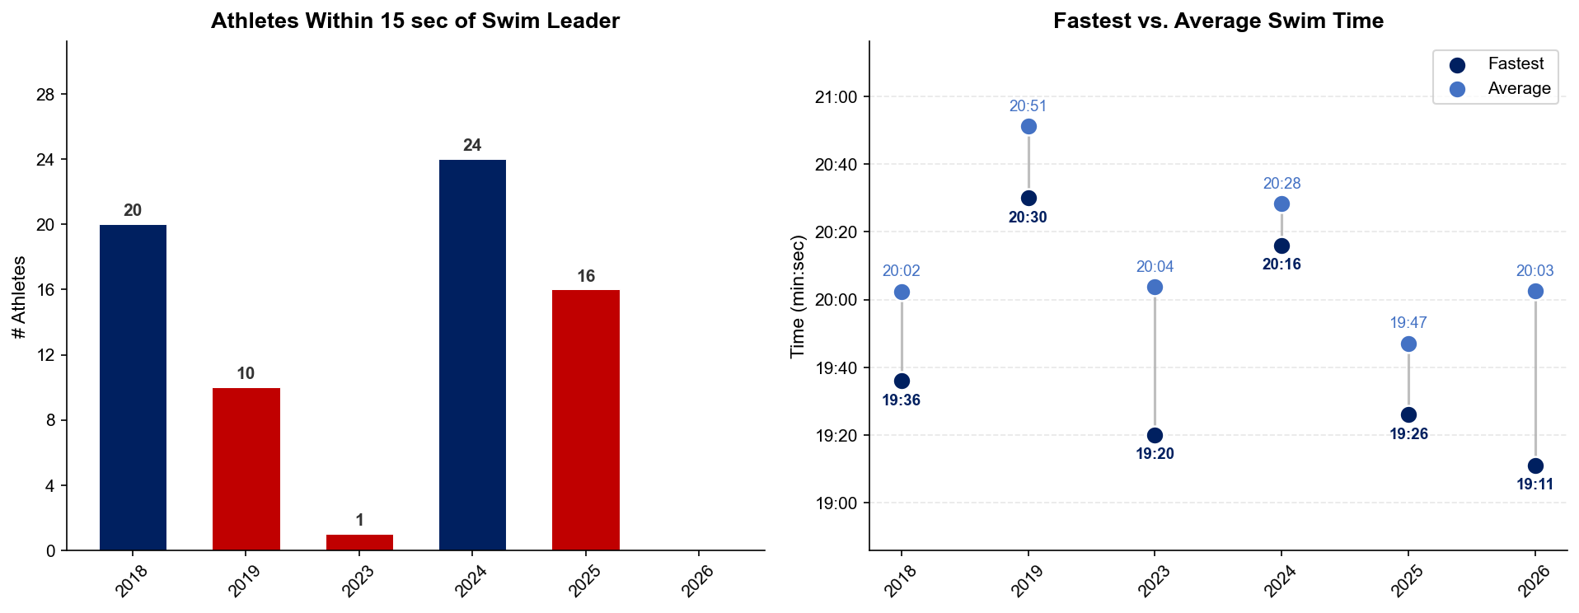
Swim Exit Dynamics — Elite Women
Weihai

Slide 28
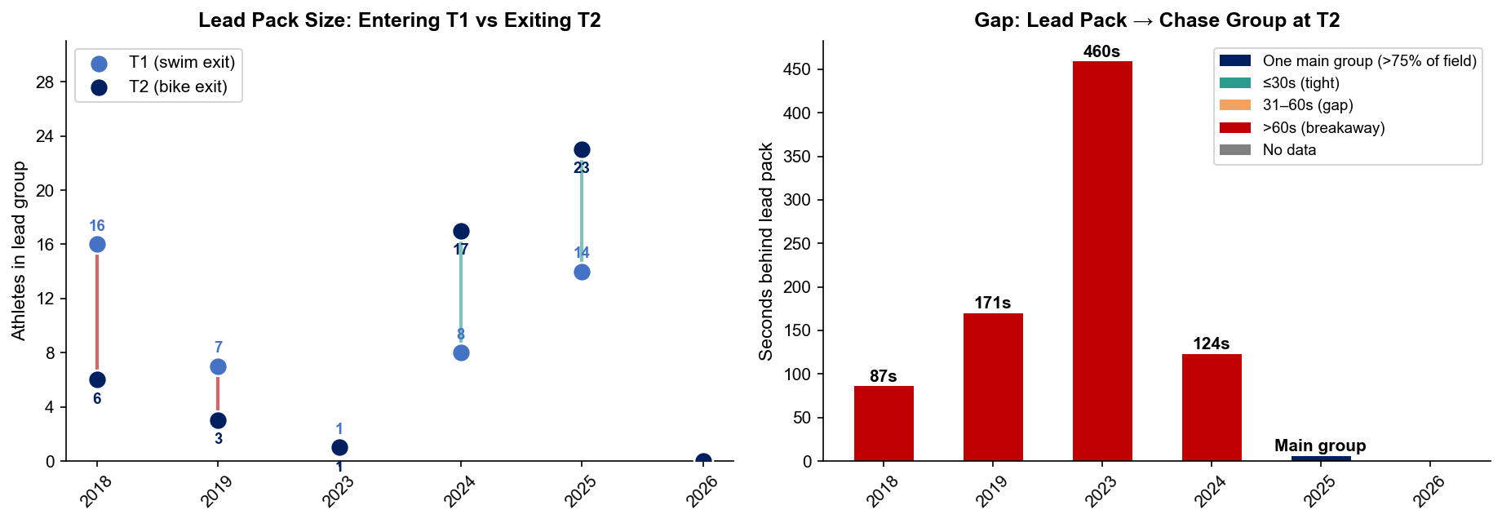
Bike Pack Evolution — Elite Women
Weihai
Lead pack = athletes within 15 sec of leader. T1 = lead group entering the bike; T2 = lead group exiting the bike.
Year | Lead Size @ T1 | Lead Size @ T2 | Change | Chase Group @ T2 | Chase Gap*
2018 | 16 | 6 | -10 | 1 | 87s
2019 | 7 | 3 | -4 | 8 | 171s
2023 | 1 | 1 | 0 | 14 | 460s
2024 | 8 | 17 | +9 | 1 | 124s
2025 | 14 | 23 | +9 | 4 | 204s
2026 | — | — | — | — | —
Lead pack = athletes within 15 sec of leader. Chase group = athletes within 15 sec of the first athlete outside the lead pack. * Chase Gap = seconds from the last lead-pack athlete to the first chase-group athlete at T2.
Dropouts: 2018: 9 DNF/LAP | 2019: 4 DNF/LAP | 2023: 7 DNF/LAP | 2024: 1 DNF/LAP | 2025: 1 DNF/LAP (1 in lead group at bike) | 2026: 3 DNF/LAP

Slide 29
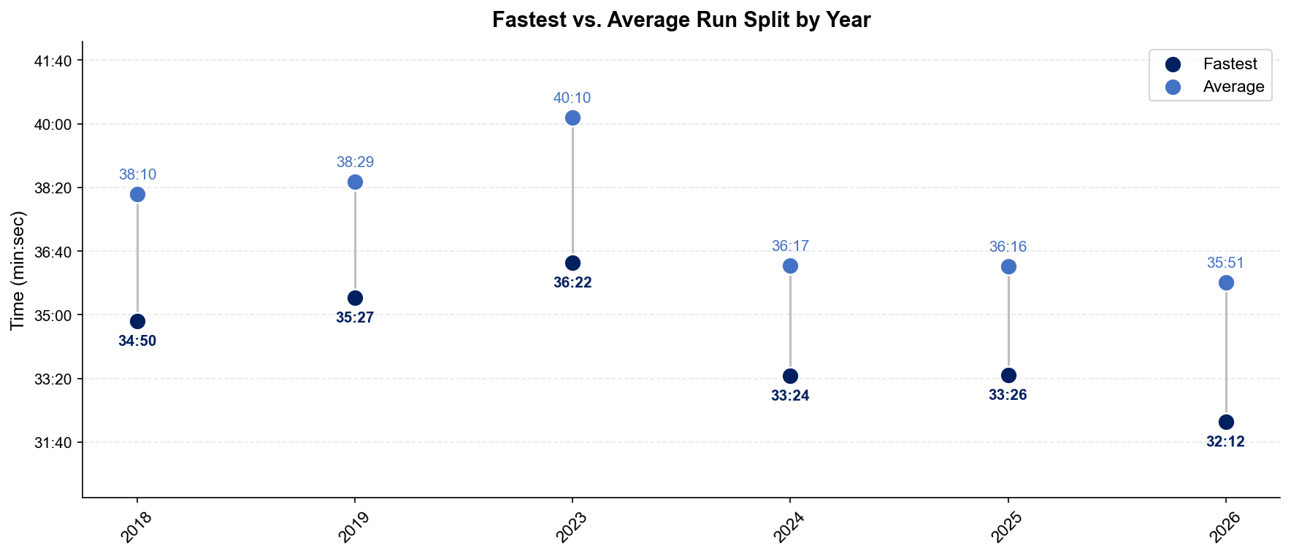
Run Split Analysis — Elite Women
Weihai

Slide 30
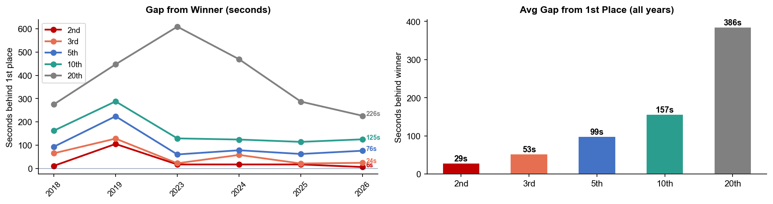
Key Position Times — Elite Women
Weihai
Year | 1st | 2nd | 3rd | 5th | 10th | 20th
2018 | 2:08:02 | 2:08:13 +11s | 2:09:07 +65s | 2:09:35 +93s | 2:10:44 +162s | 2:12:37 +275s
2019 | 2:08:03 | 2:09:48 +105s | 2:10:11 +128s | 2:11:47 +224s | 2:12:51 +288s | 2:15:30 +447s
2023 | 1:58:42 | 1:58:59 +17s | 1:59:04 +22s | 1:59:42 +60s | 2:00:51 +129s | 2:08:51 +609s
2024 | 2:04:42 | 2:04:59 +17s | 2:05:40 +58s | 2:06:00 +78s | 2:06:46 +124s | 2:12:31 +469s
2025 | 1:51:58 | 1:52:15 +17s | 1:52:19 +21s | 1:53:00 +62s | 1:53:52 +114s | 1:56:45 +287s
2026 | 1:49:20 | 1:49:26 +6s | 1:49:44 +24s | 1:50:36 +76s | 1:51:25 +125s | 1:53:06 +226s

Slide 31
Race Conditions — Elite Women
Weihai
Year | Date | Air Temp | Humidity | Wind (km/h) | Precip (mm) | Water Temp | Wetsuit | Conditions
2018 | Sep 22 | 23.5°* | 39% | 9 | 0.0 | — | — | —
2019 | Sep 21 | 23.3°* | 66% | 20 | 0.0 | — | — | —
2023 | Aug 26 | 31.9 | 60% | 16 | 0.0 | 25.9 | forbidden | —
2024 | Sep 27 | 28 | 62% | 14 | 0.0 | 24.8 | forbidden | —
2025 | Sep 26 | 28.9 | 78% | 8 | 0.0 | 24.3 | forbidden | —
2026 | Aug 29 | 24.7 | 84% | 9 | 1.3 | 26.3 | forbidden | —
Air temp, humidity, wind, and precipitation sourced from Open-Meteo historical archive (race window 09:00–14:00 local) where WT API data is absent. Values marked * are Open-Meteo estimates. Water temp and wetsuit ruling are from the World Triathlon API per program.

